Slide 1
SEALS + Light Scattering Report
UCLA Jalali Lab
09/18/21
Presented by: Charles Bai

Slide 2
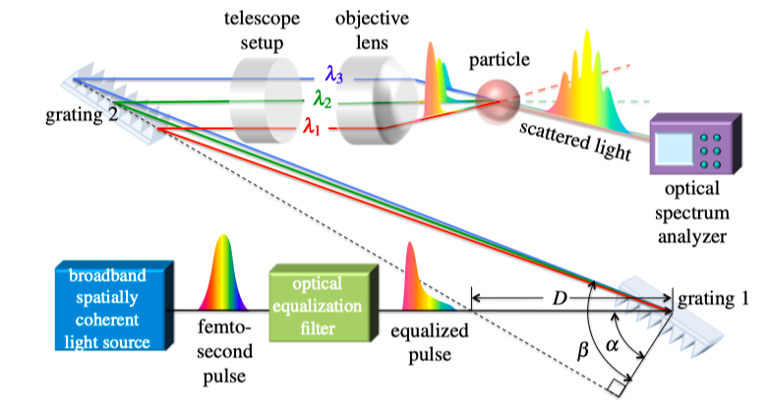
SEALS System Review
Optical components mapping scattering angle to wavelength.
OSA used to get spectrogram.
Returned scattering information used to identify particle.
Normal scatterometer: not as cost efficient/less measurements.
One detector precludes issue of matching detectors.
Relevant files:
main.m, SEALS.m

Slide 3
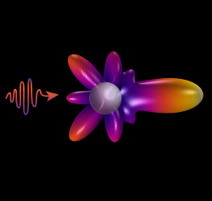
Scattering Model Summary
Models for Mie and Rayleigh Debye.
(Rayleigh Debye for when refractive indexes are similar)
(Mie is for simulation of spherical particles in general)
Simulation of intensity to scattering angle.
Mie model returns other information.
Relevant files:
main.m, rayleighdebye.m, mie.m

Slide 4
Project Goals
Combine the two projects, represent the expected output of SEALS using the scattering model.
Input matches what you would input into both systems + a few other options. Wavelength range, measurement angle.
Output matches relevant outputs from both systems. This model also provides phase vs. scattering angle (for Mie) and intensity vs. wavelength.

Slide 5
Simulator System
System Inputs to main.m:
Particle diameter
Refractive index for sphere
Refractive index for ambient
Measurement distance
Raymie or Mie
Groove Spacing
Distance between gratings
Grating tilt angle
Lens diameter
Numerical Aperture
Measurement Angle
Wavelength Distribution
Dcorr
System Outputs of main.m:
Wavelength vs. scattering angle mapping.
Displacement vs. scattering angle mapping.
Scattering cross section
Mie coefficients.
Intensity vs. scattering angle. (cartesian and polar)
Phase vs. scattering angle
(s and p polarization)
Intensity vs. wavelength distribution.
SEALS Component
seals.m
Scattering Component
rayleighdebye.m and mie.m
SEALS Component Local Output:
Wavelength vs. scattering angle mapping.
Displacement vs. scattering angle mapping.
System Intensity Distribution.
Scattering Angle Range.
Scattering Component Local Output:
Scattering cross section
Mie coefficients.
Intensity vs. scattering angle Phase vs. scattering angle
(s and p polarization)

Slide 6

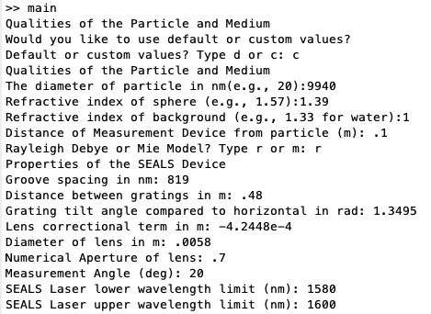
User Interface
Choice between default or custom values.
Input values and choice between Rayleigh or Mie.
Relevant File: main.m

Slide 7
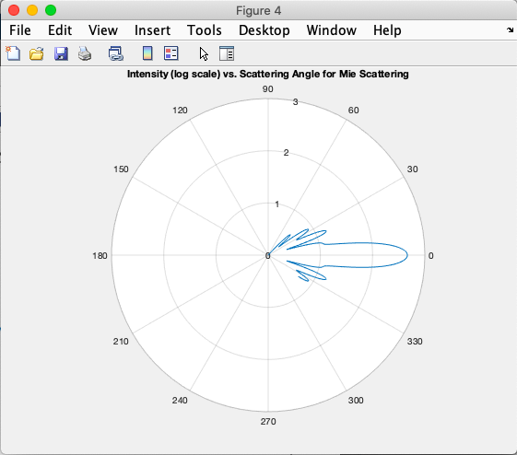
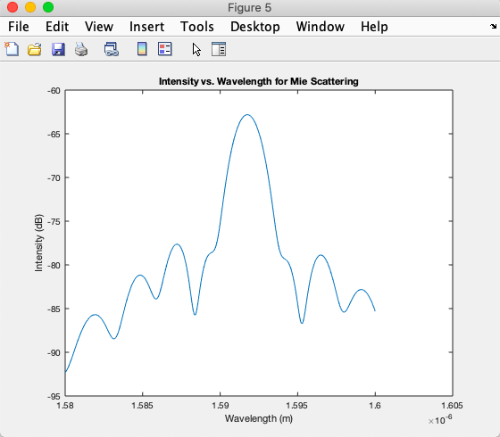
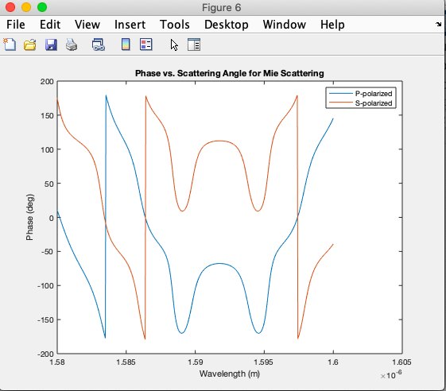
Results from Code (Mie)
Intensity vs. wavelength and scattering angle.
Phase data.
Mie coefficients, scattering coefficients saved.
Relevant Files: main.m, mie.m

Slide 8
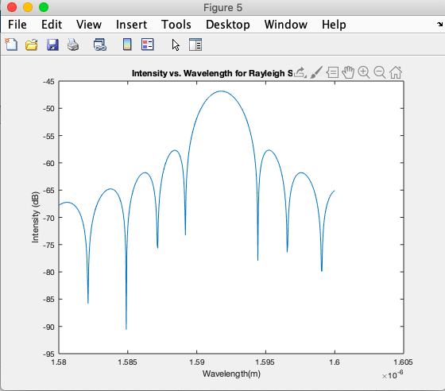
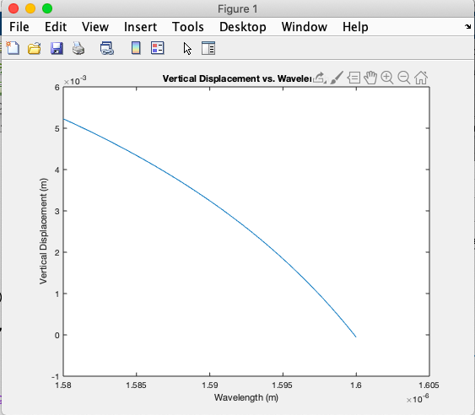
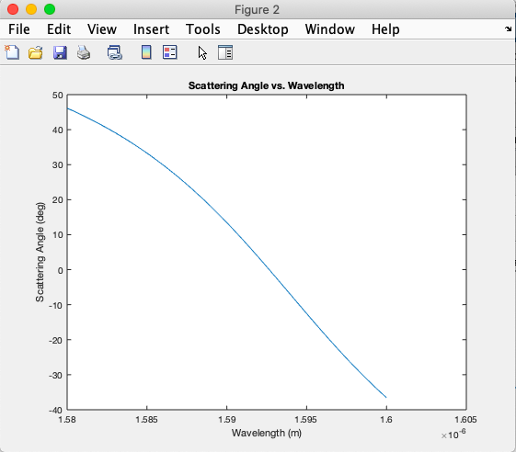
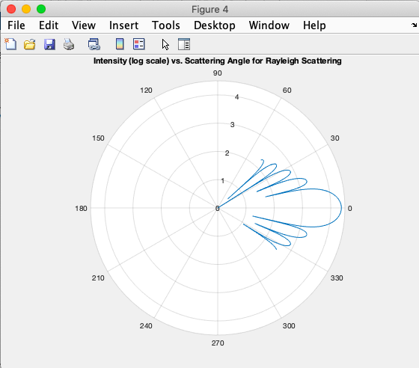
Results from Code (RDG and SEALS)
Intensity vs. wavelength and scattering angle.
Data from SEALS component.
Relevant files: rayleighdebye.m, SEALS.m, main.m.

Slide 9
Future Prospects
The Rayleigh Debye model does not have a phase simulator.
Replacing intensity spectrogram of laser light.

